Slide 1


Web Development
Week 4
Part 2: Basic Security
Abertay
abertay.ac.uk

Slide 2
Basic Security
Main ideas:
There are many types of attacks and security threats
These are some of the ways to deal with some of them
There are alternative solutions to threats

Slide 3



Lines of Defence
1
2
3
4

Slide 4
SQL Injection Attacks
Abertay
abertay.ac.uk

Slide 5
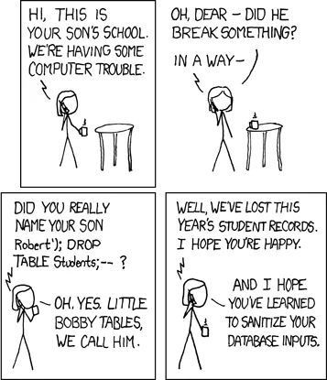
SQL Injection Attacks

Slide 6
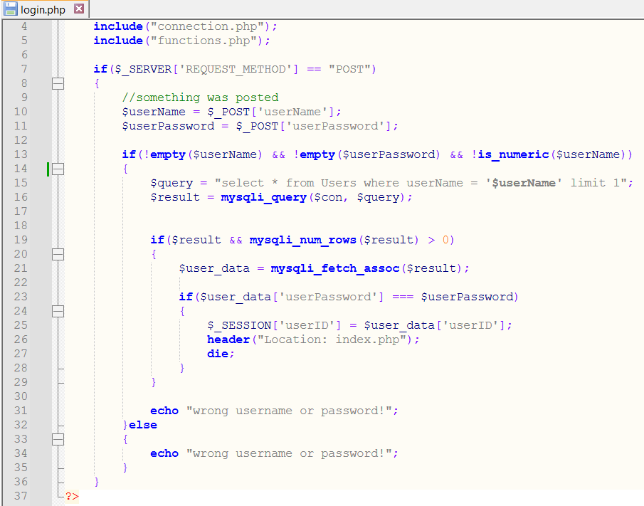
SQL Injection Attacks
https://www.w3schools.com/sql/sql_injection.asp

Slide 7
Input validation
Abertay
abertay.ac.uk

Slide 8
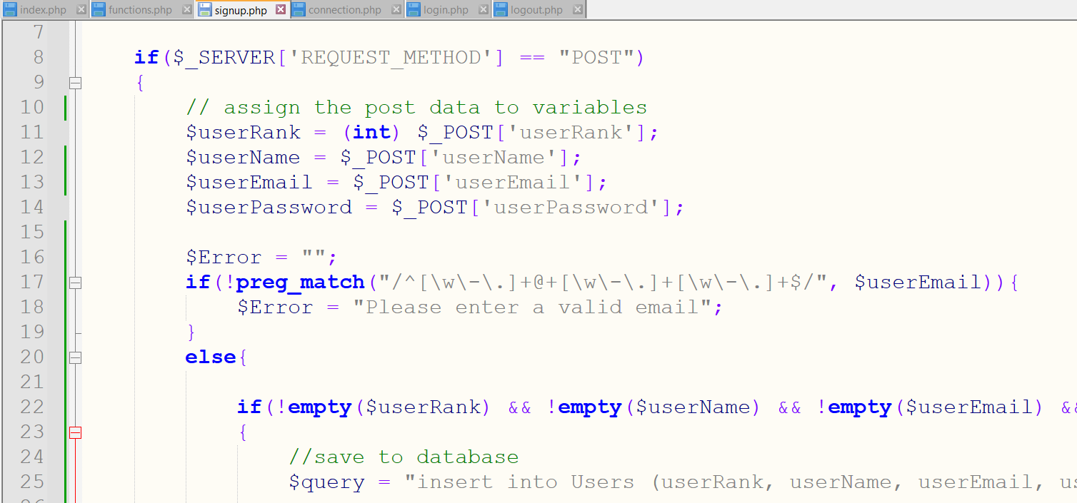
Input validation
https://www.w3schools.com/php/func_regex_preg_match.asp

Slide 9
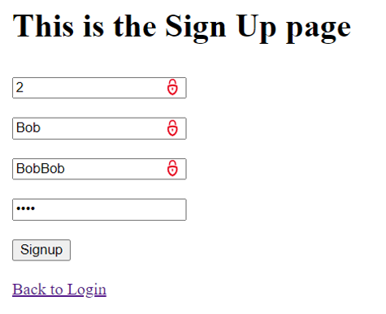
Input validation

Slide 10
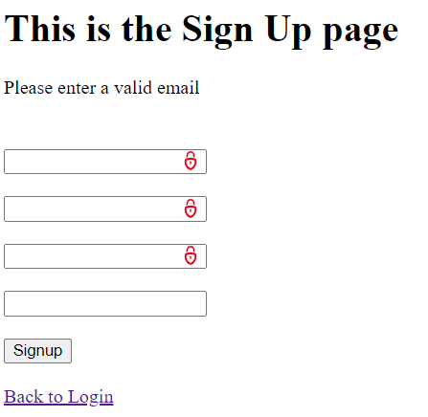
Input validation

Slide 11
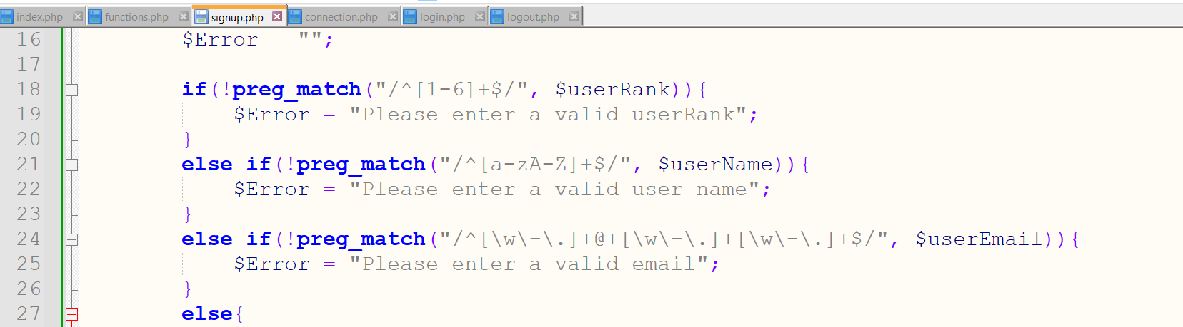
Input validation

Slide 12
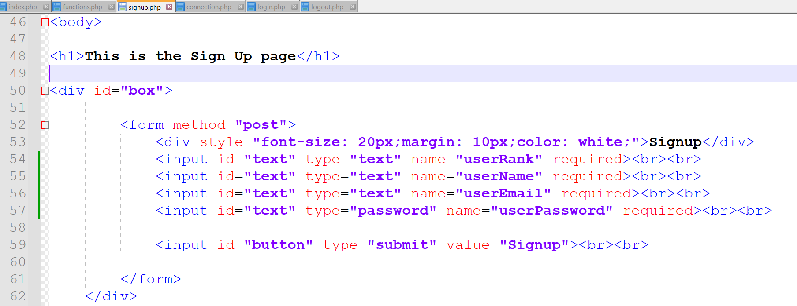
Input validation
https://www.w3schools.com/tags/att_input_required.asp

Slide 13
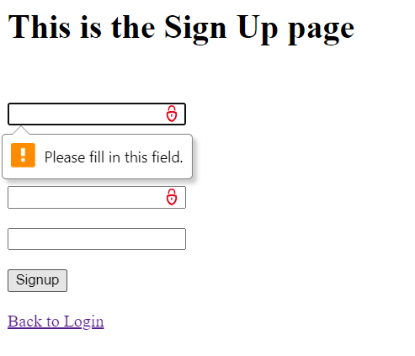
Input validation

Slide 14
Sanitising Input
Abertay
abertay.ac.uk

Slide 15
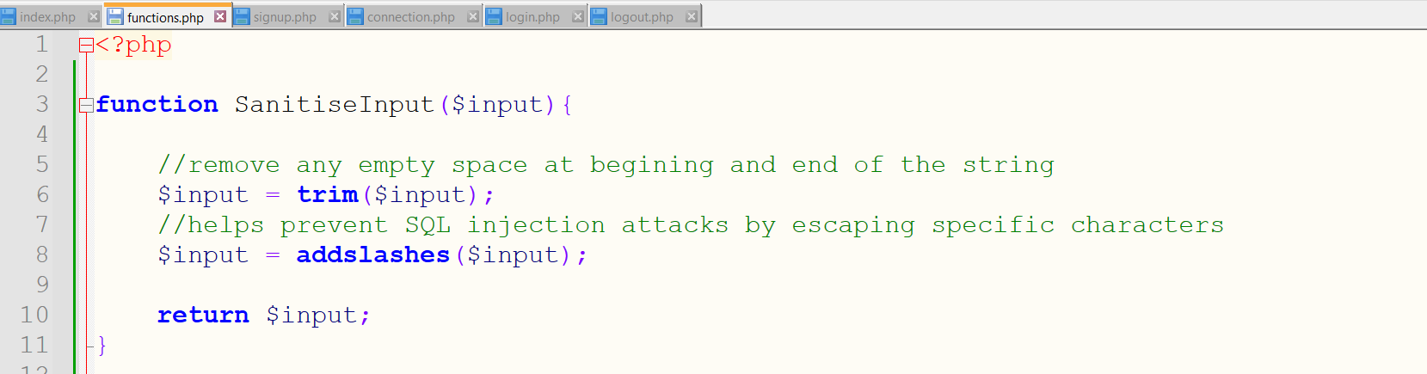
Sanitise Input

Slide 16
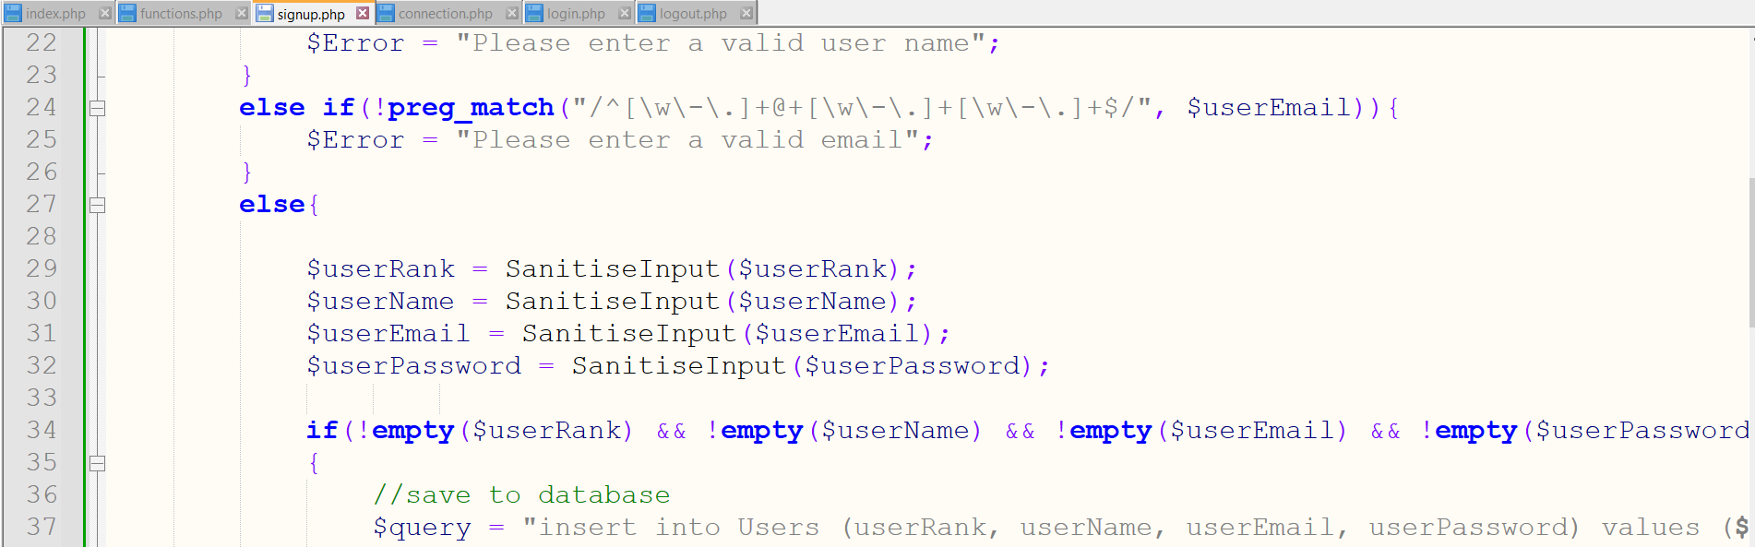
Sanitise Input
https://www.w3schools.com/php/filter_sanitize_string.asp

Slide 17
Prepared Statements
Abertay
abertay.ac.uk

Slide 18
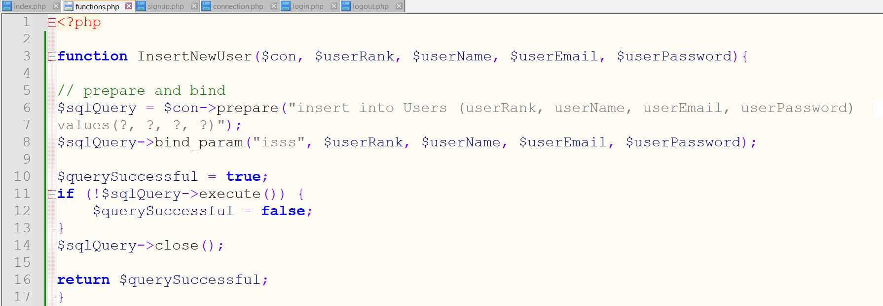
Prepared Statements
Important to close connection to database
https://www.w3schools.com/php/php_mysql_prepared_statements.asp

Slide 19
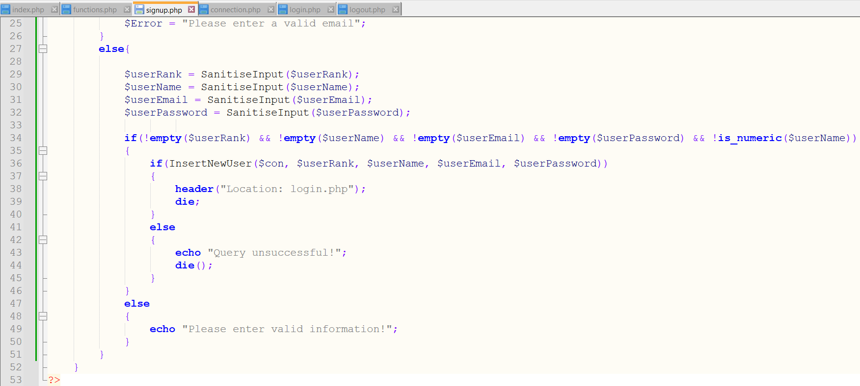
Prepared Statements

Slide 20
HTML Escaping
Abertay
abertay.ac.uk

Slide 21
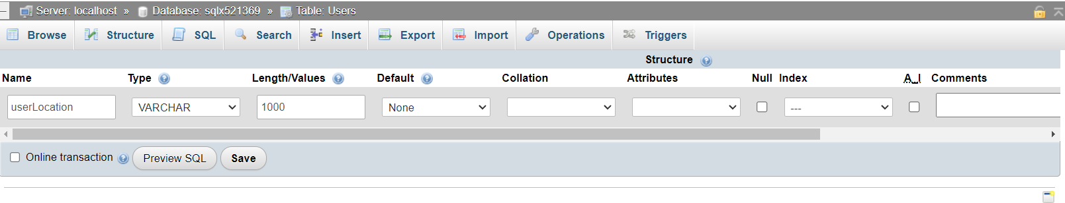
HTML Escaping
Warning if you try this yourself it will break your signup page as there is no default value for this column
To fix this either delete the column after testing or add location to your insertion of new users

Slide 22
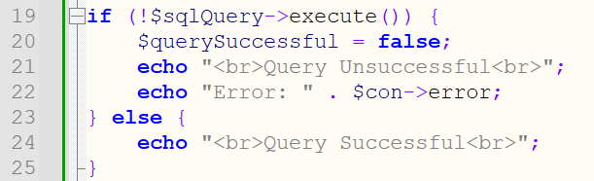
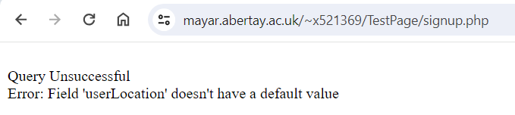
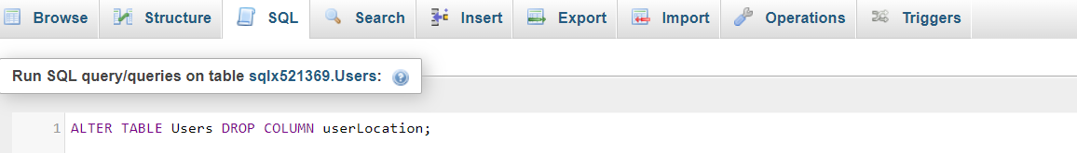
A Slight Tangent on Debugging

Slide 23
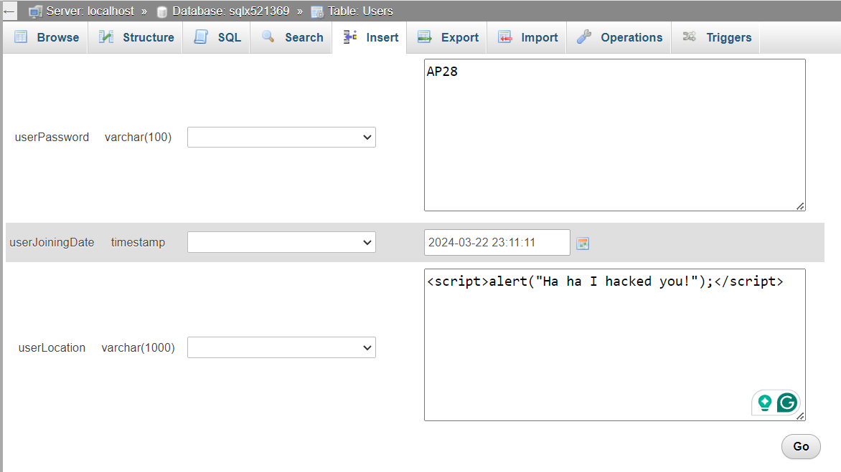
Back to HTML Escaping

Slide 24
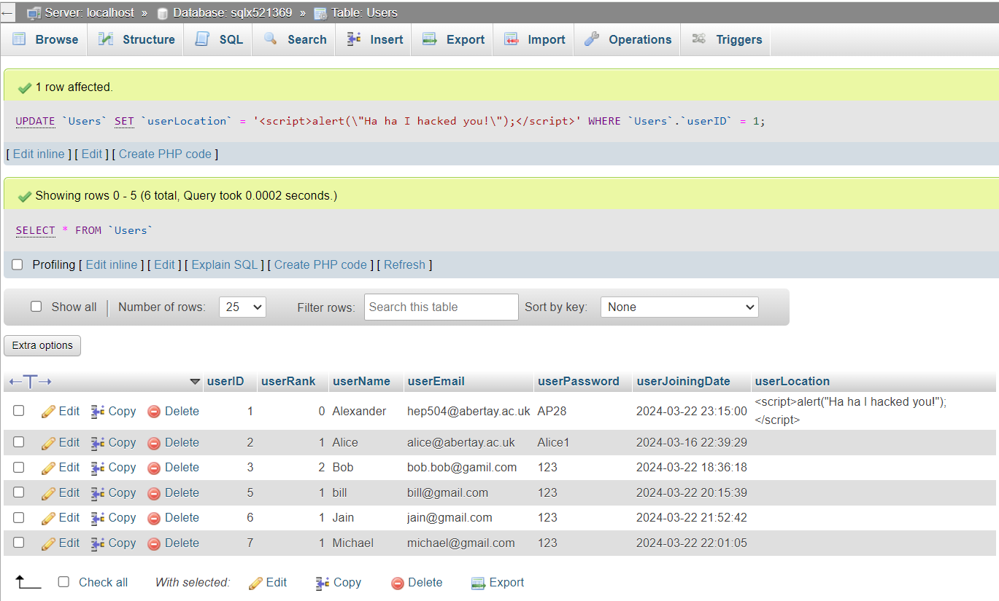
HTML Escaping

Slide 25
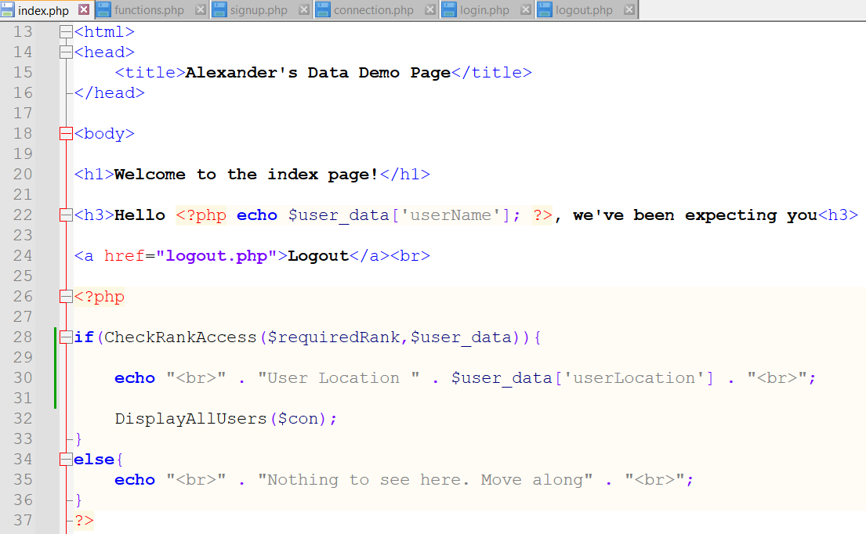
HTML Escaping

Slide 26
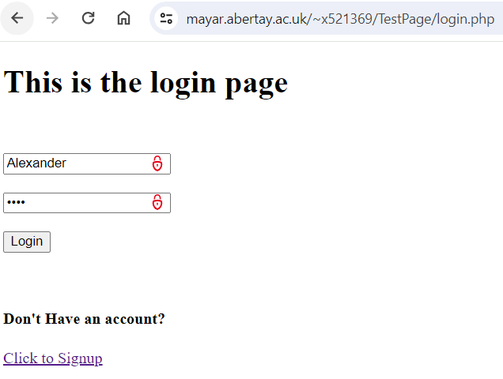
HTML Escaping

Slide 27
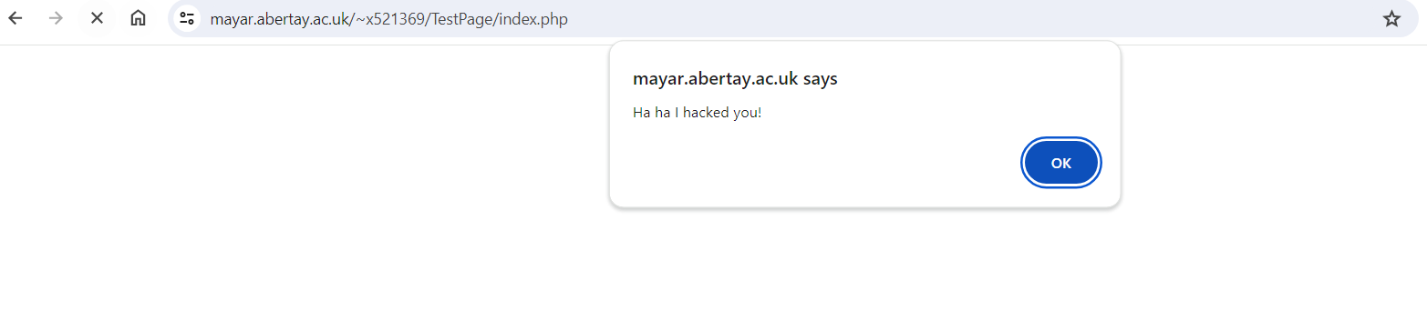
HTML Escaping

Slide 28
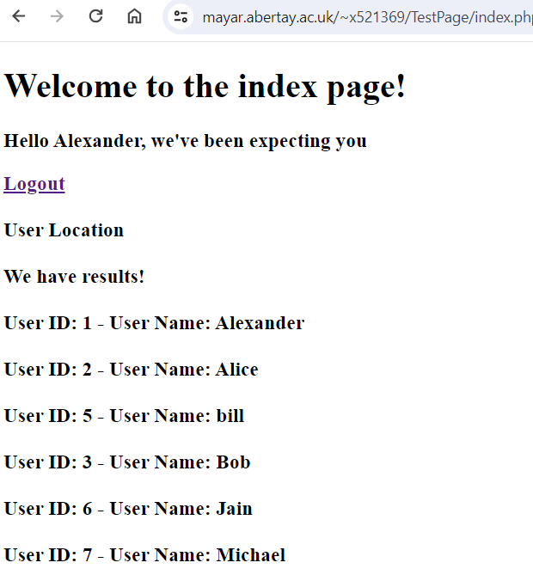
HTML Escaping

Slide 29
HTML Escaping

Slide 30
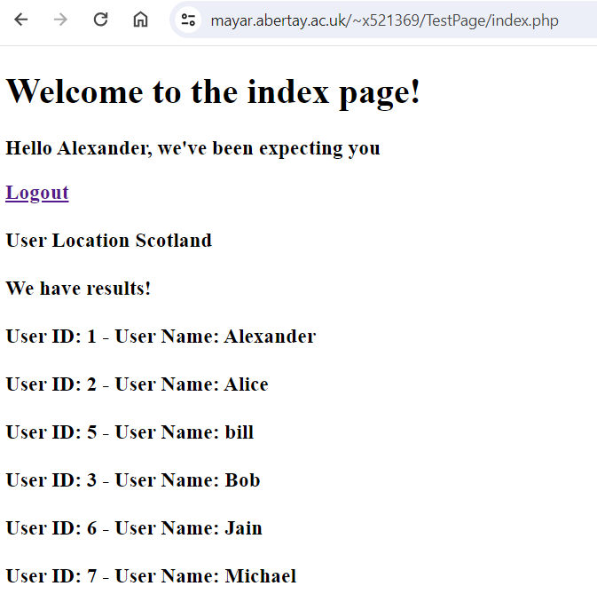
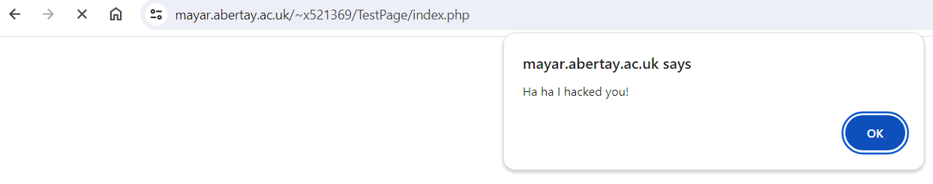
HTML Escaping

Slide 31
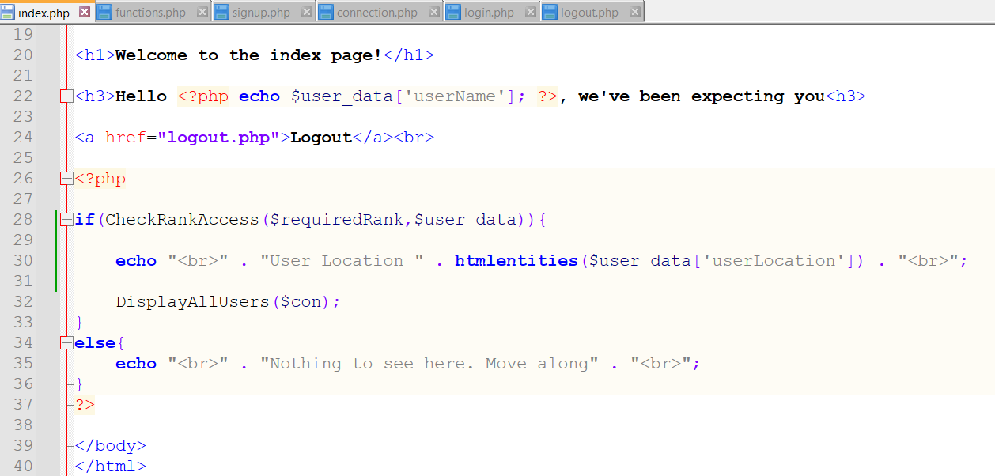
HTML Escaping
https://www.w3schools.com/html/html_entities.asp

Slide 32
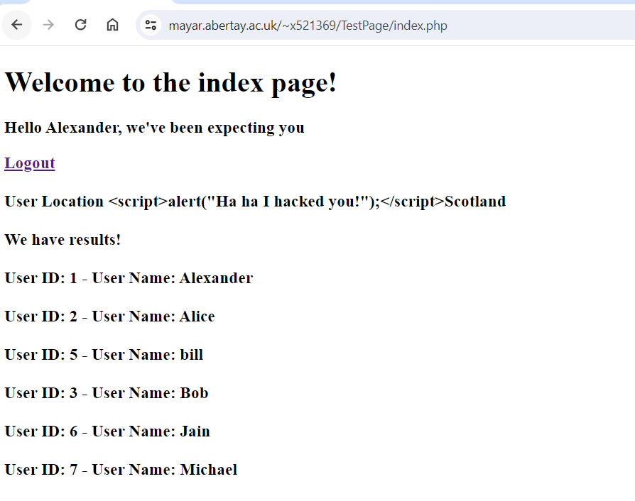
HTML Escaping

Slide 33
Cross Site Request Forgery
Abertay
abertay.ac.uk

Slide 34
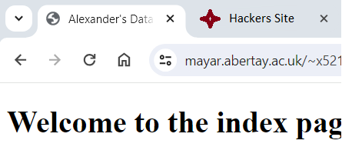
CSRF Tokens (Cross Site Request Forgery)
Bank Website
Hackers Website
Malicious Request

Slide 35
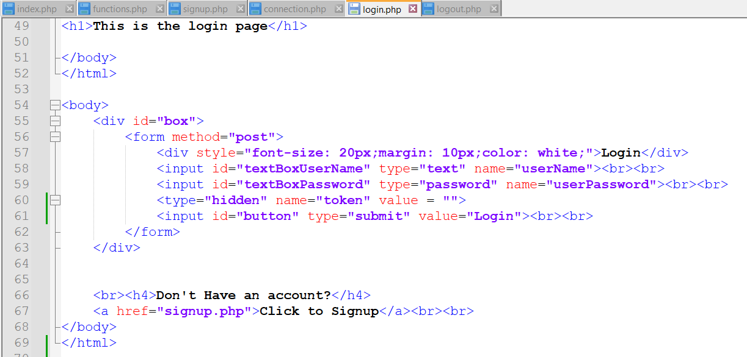
CSRF Tokens (Cross Site Request Forgery)

Slide 36
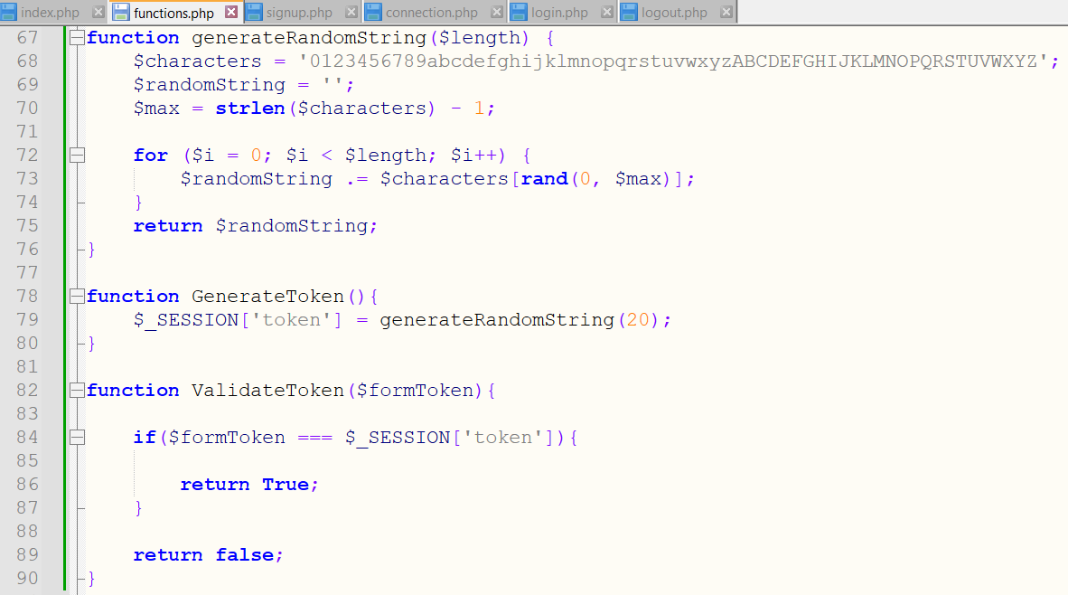
CSRF Tokens (Cross Site Request Forgery)

Slide 37
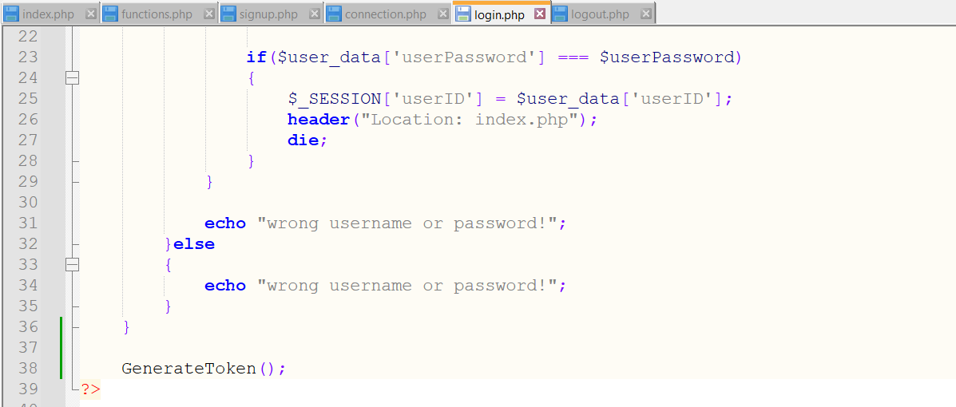
CSRF Tokens (Cross Site Request Forgery)
Very important it's at the bottom!

Slide 38
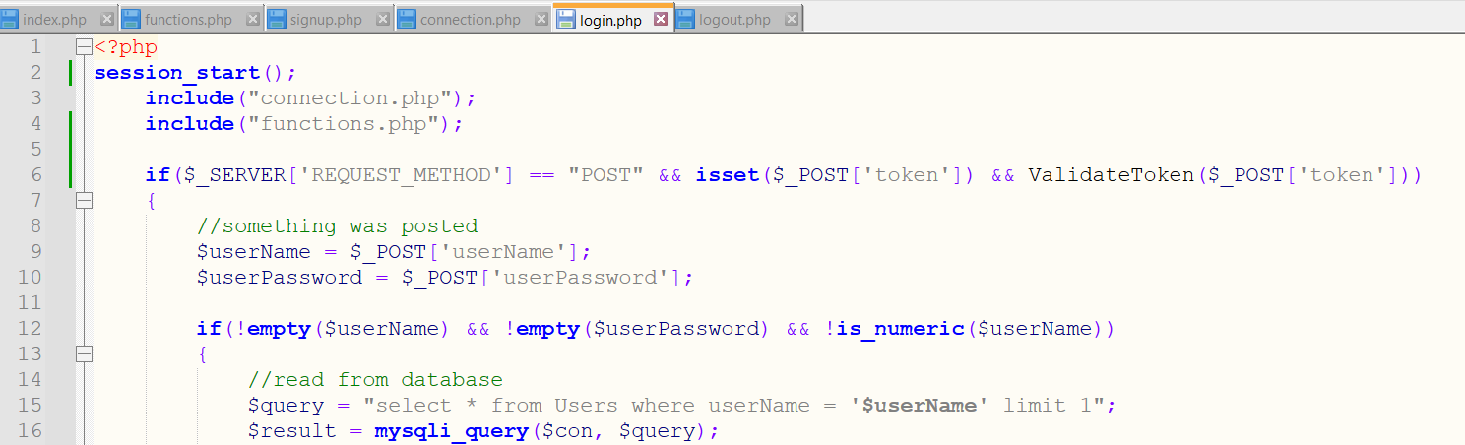
CSRF Tokens (Cross Site Request Forgery)

Slide 39
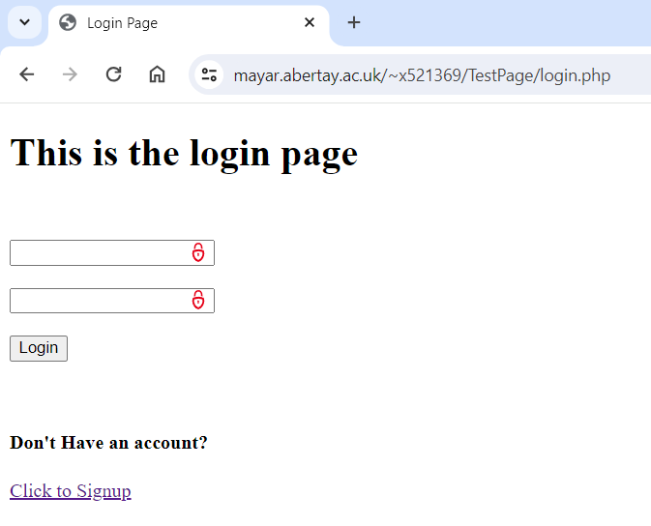
CSRF Tokens (Cross Site Request Forgery)

Slide 40
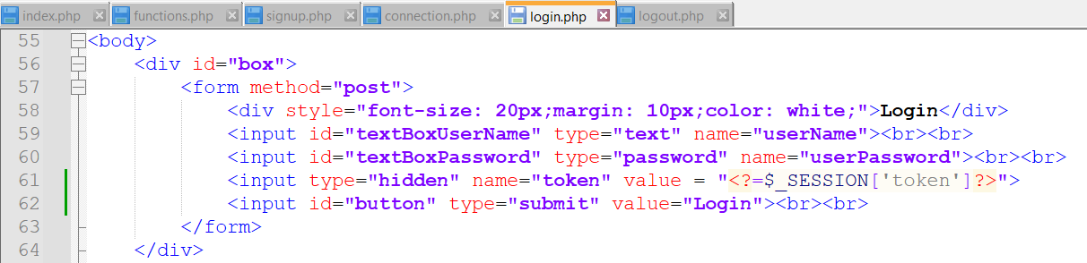
CSRF Tokens (Cross Site Request Forgery)

Slide 41
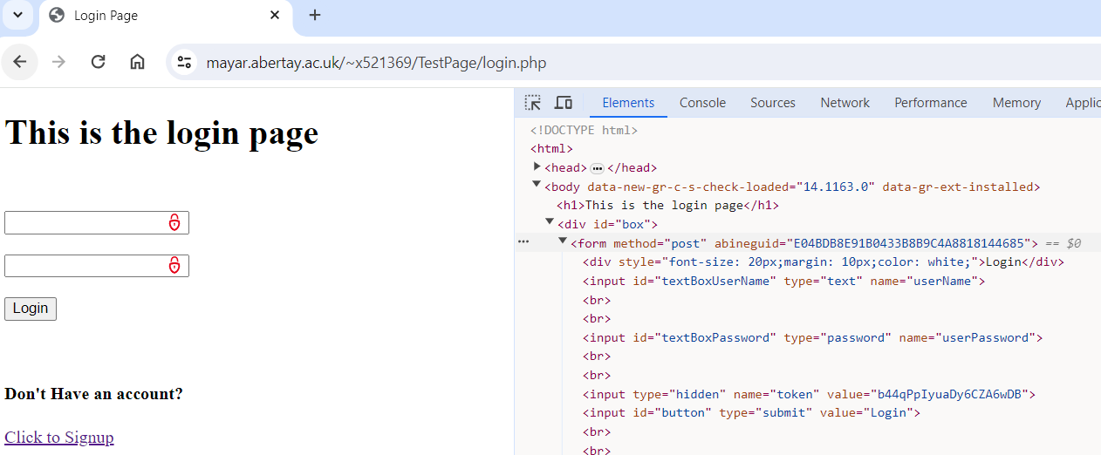
CSRF Tokens (Cross Site Request Forgery)

Slide 42
Password Hashing and Salt
Abertay
abertay.ac.uk

Slide 43
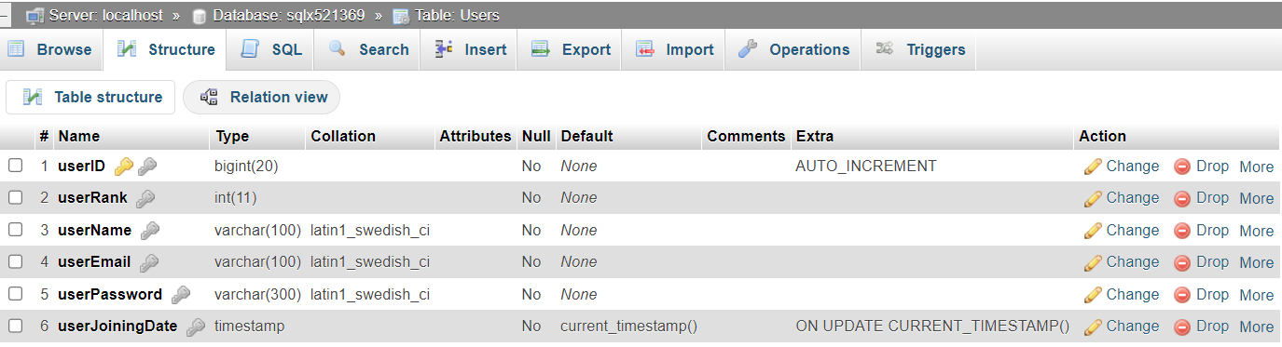
Password Hashing

Slide 44
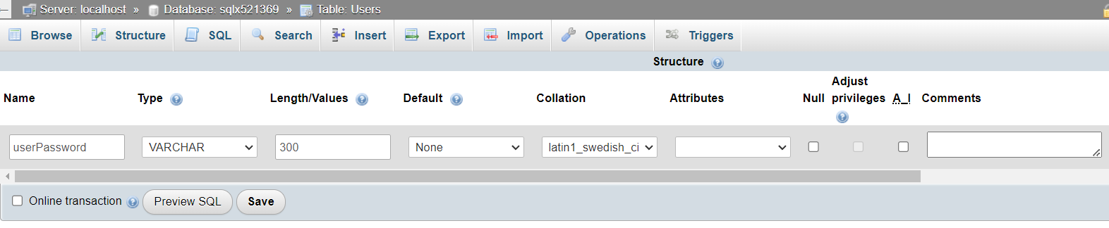
Password Hashing
Increase the userPassword Length or the passwords could be truncated. A Length of 255 is recommended

Slide 45
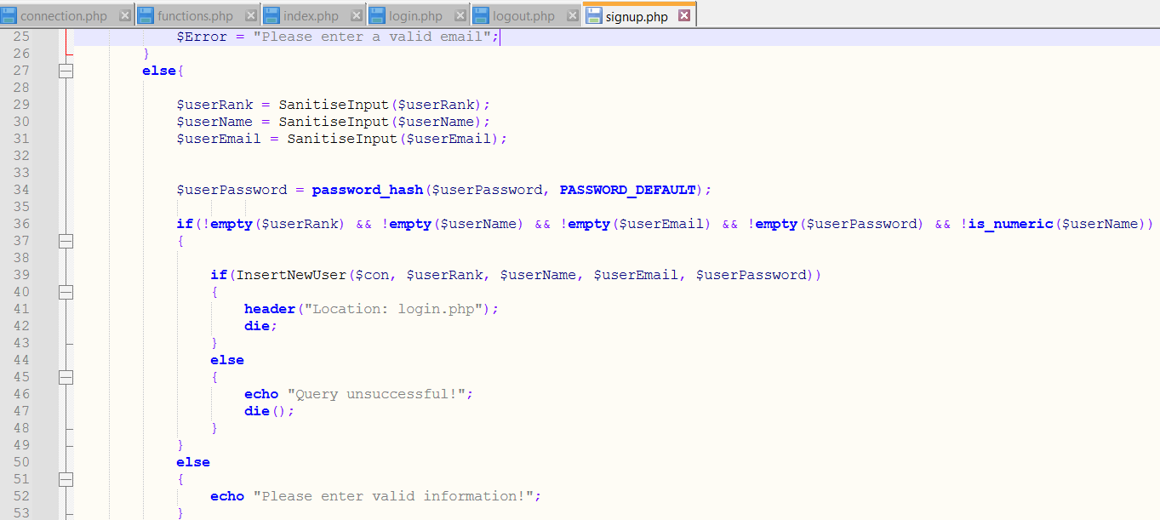
Password Hashing

Slide 46
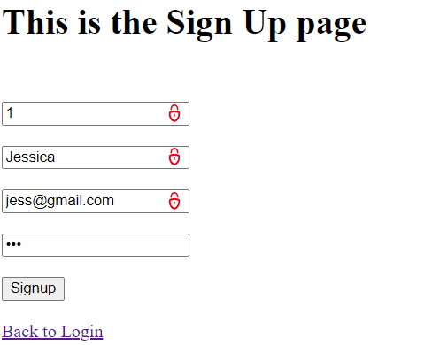
Password Hashing
Password = 123

Slide 47
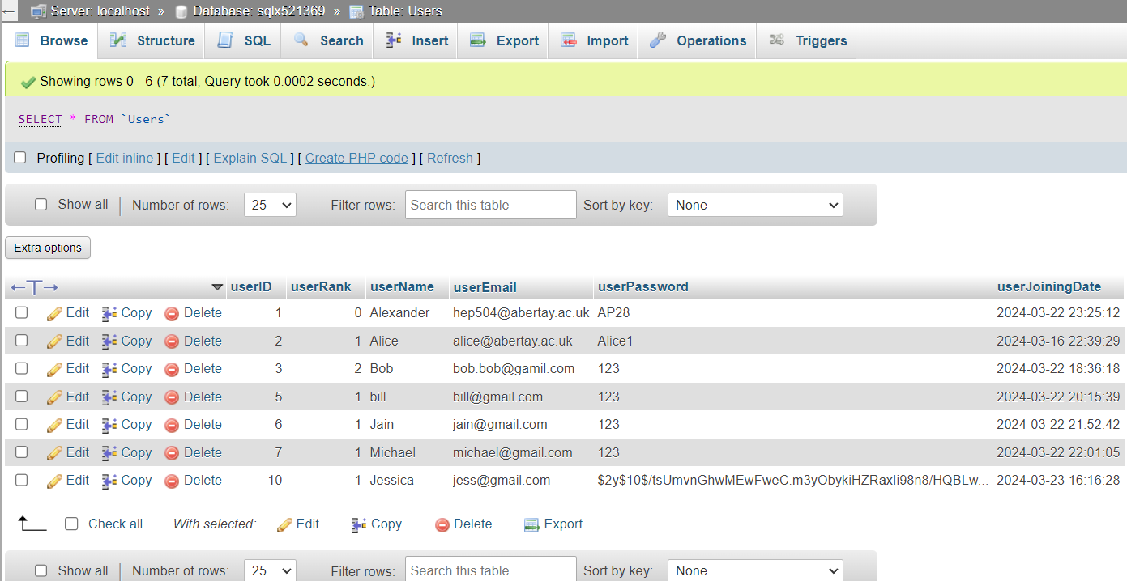
Password Hashing

Slide 48
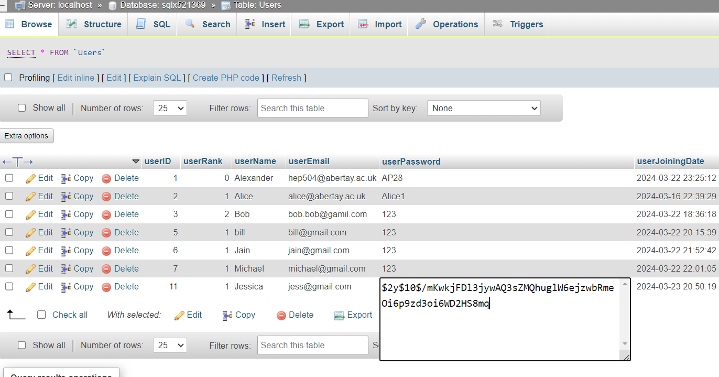
Password Hashing

Slide 49
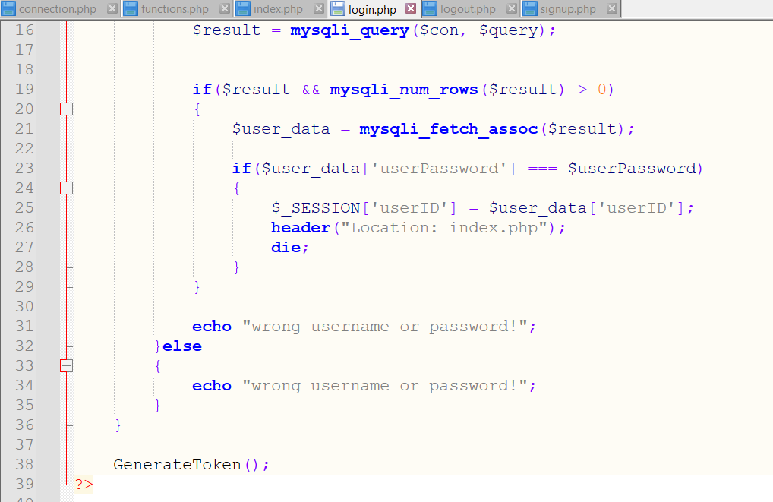
Password Hashing
Broken!

Slide 50
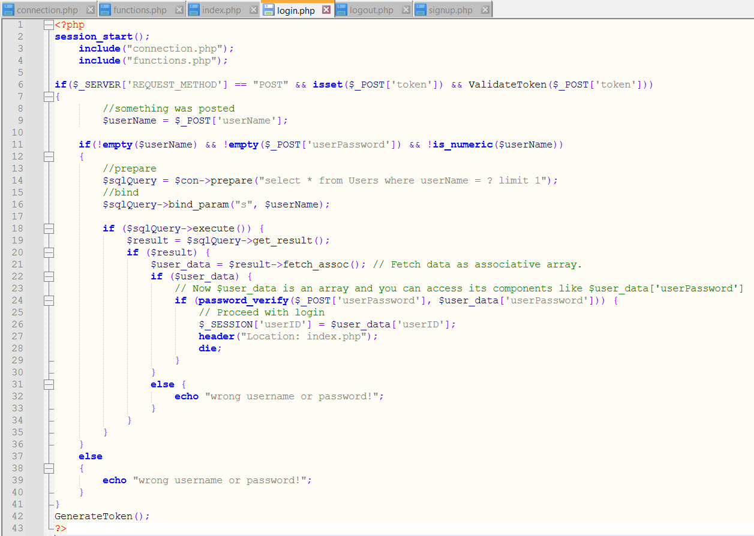
Password Hashing
Fixed!

Slide 51
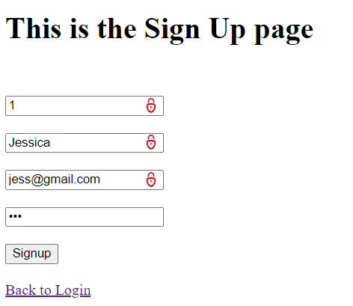
Password Hashing
Password = 123

Slide 52
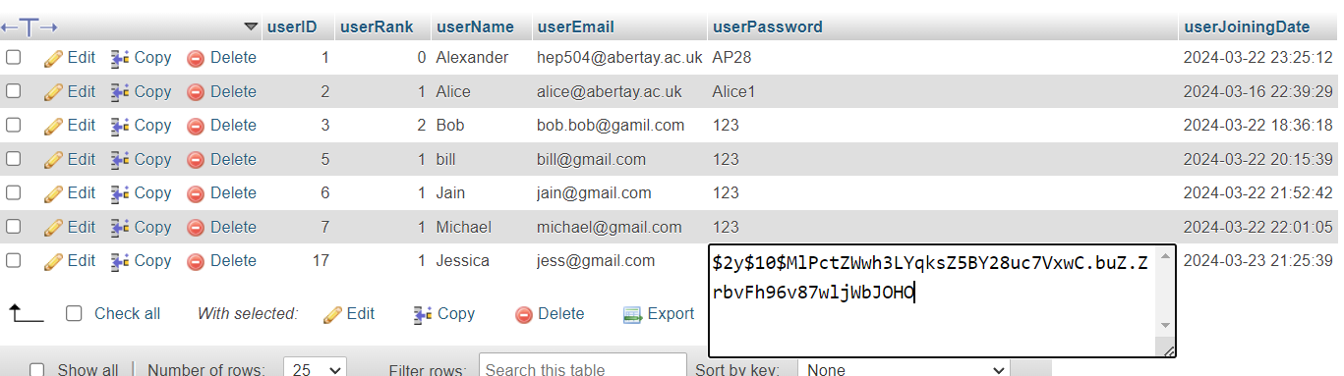
Password Hashing

Slide 53
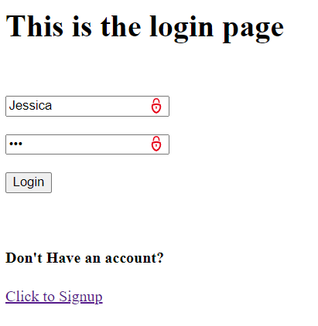
Password Hashing
Password = 123

Slide 54
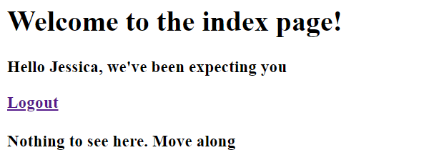
Password Hashing

Slide 55
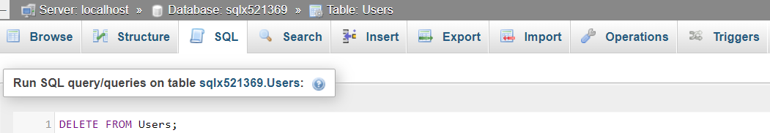
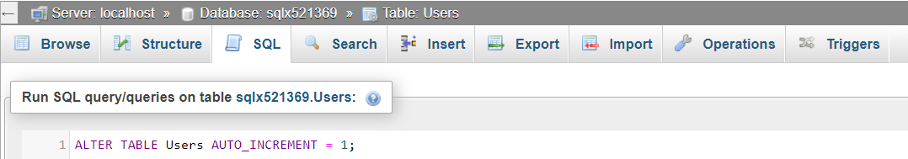
Password Hashing

Slide 56
But what about the Salt?
Abertay
abertay.ac.uk

Slide 57
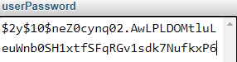


Salt?
Hash
123
123
Password
User
Bob
Jain

Slide 58
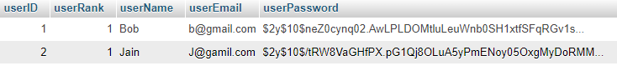
Salt
Hash
123
123
Password
User
Bob
Jain

Slide 59
But Where is The Salt?

Slide 60
Other Security Measures?
Abertay
abertay.ac.uk

Slide 61

File structure

Slide 62
Next Week’s Topics?
Developing Accessible Websites
Producing Planning Documentation
Using Multiple Tables in a Database
Abertay
abertay.ac.uk

Slide 63
Questions and Errors
Abertay
abertay.ac.uk

